Slide 1
ORACLES forecasting Briefing Meteorology
Briefing on 04-09-2016 8am
Forecasting for flight #5 target opt on 06/09 but looking at 5/9-09-2016

Slide 2
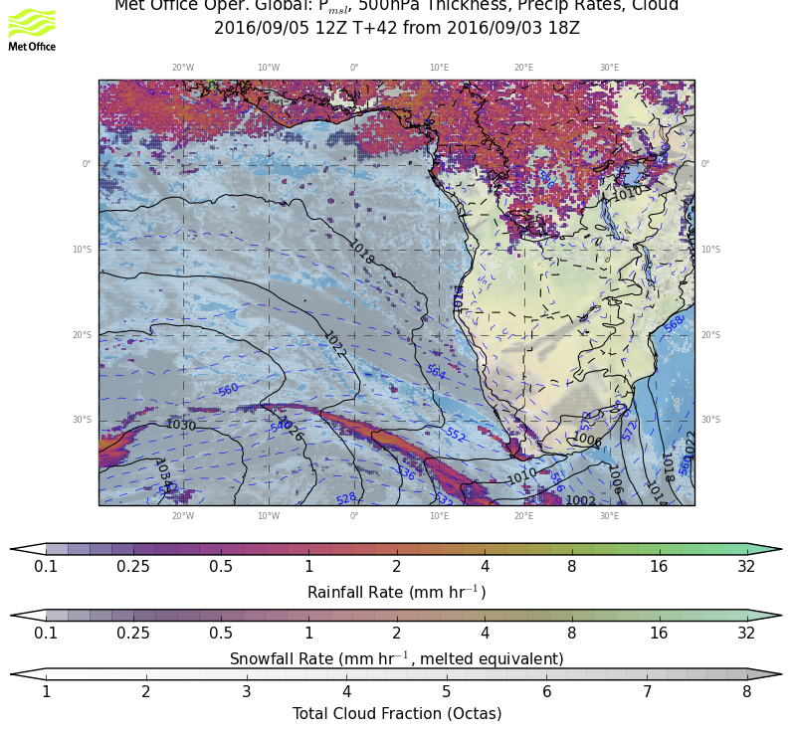
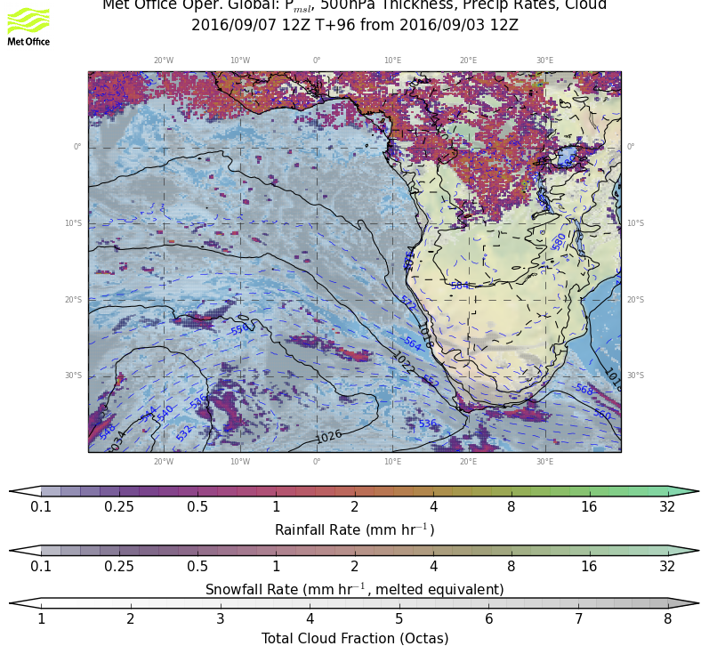
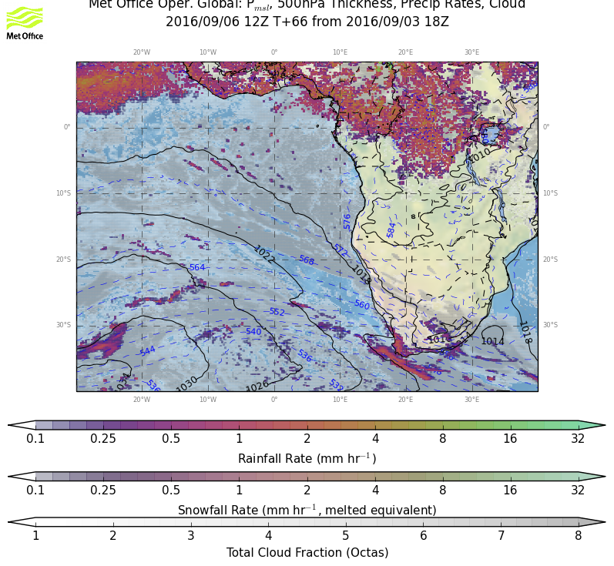
9/5 MONDAY, 12Z
9/7 Wednesday 12Z
Weather overview:
P msl
Cloud cover
Precip
9/8 Thursday12Z
9/6 TUESDAY, 12Z

Slide 3
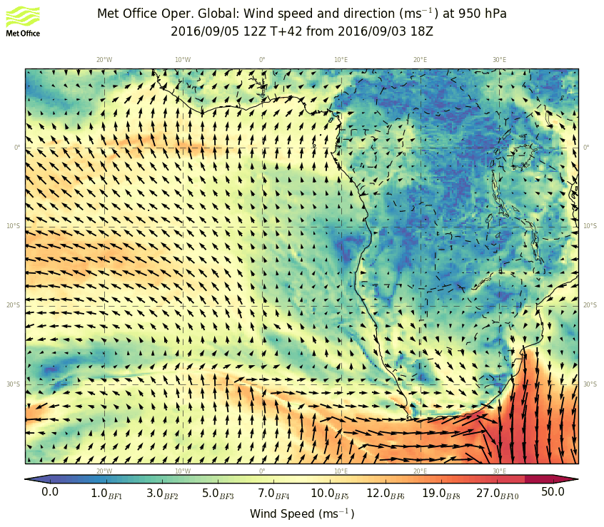
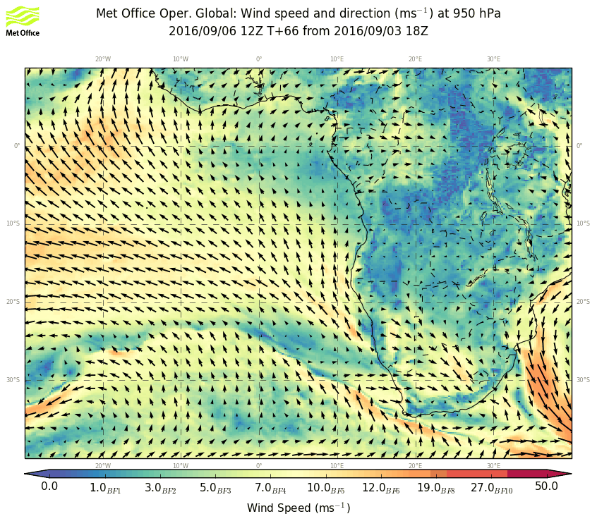
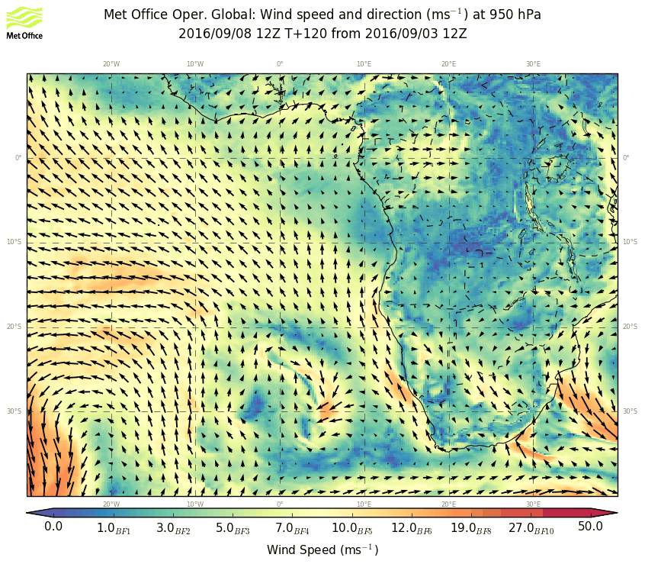
9/5 MONDAY, 12Z
9/7 Wednesday 12Z
WIND 950 hPA
9/6 TUESDAY, 12Z
9/8 Thursday12Z

Slide 4
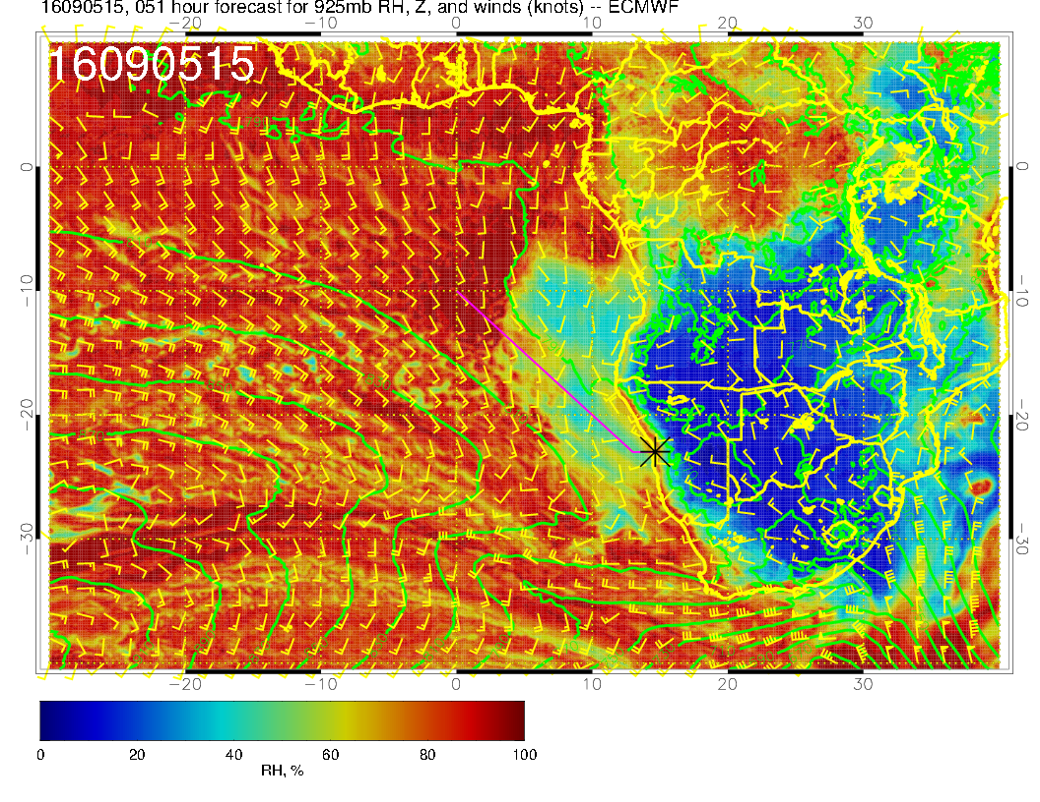
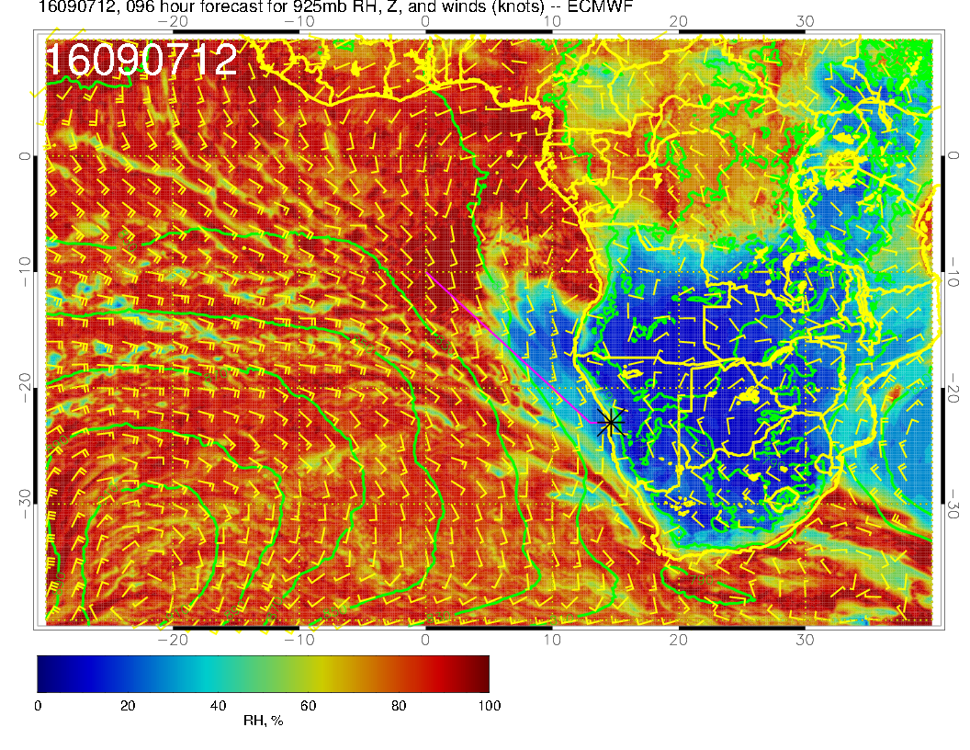
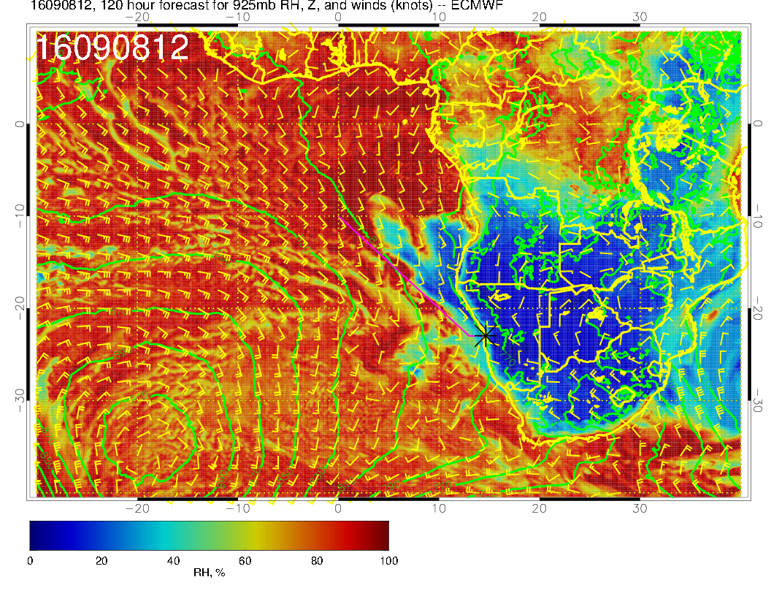
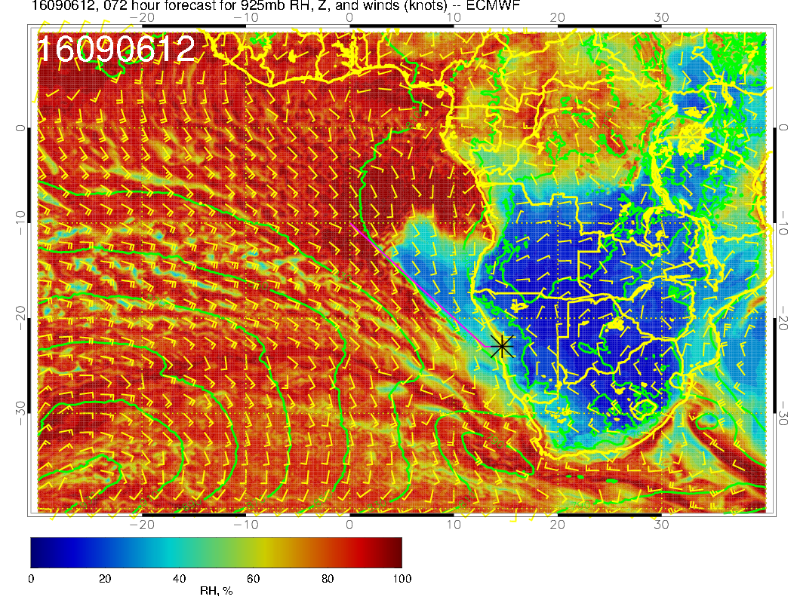
9/5 MONDAY, 15Z
9/7 Wednesday 12Z
WIND & RH 950 hPA
9/6 TUESDAY, 12Z
9/8 Thursday12Z

Slide 5
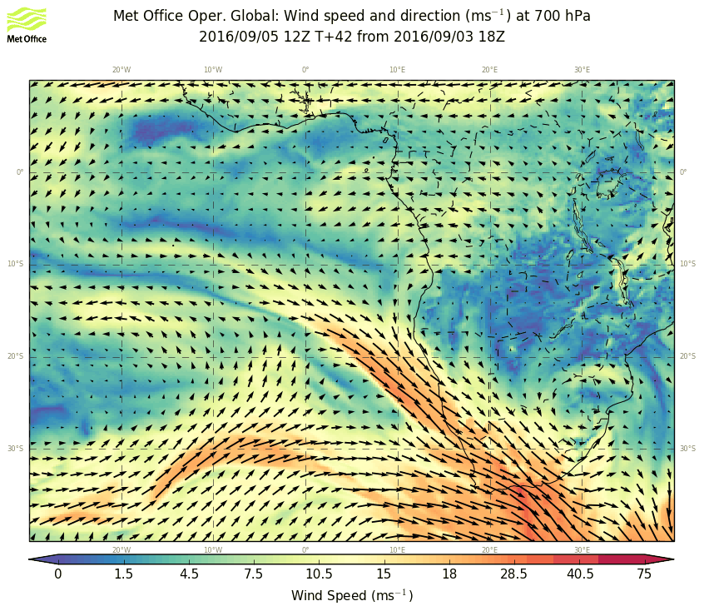
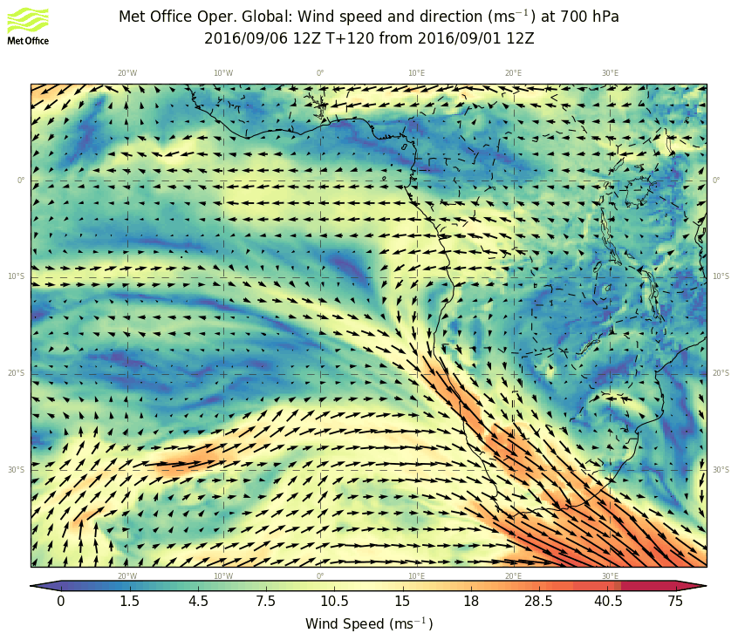
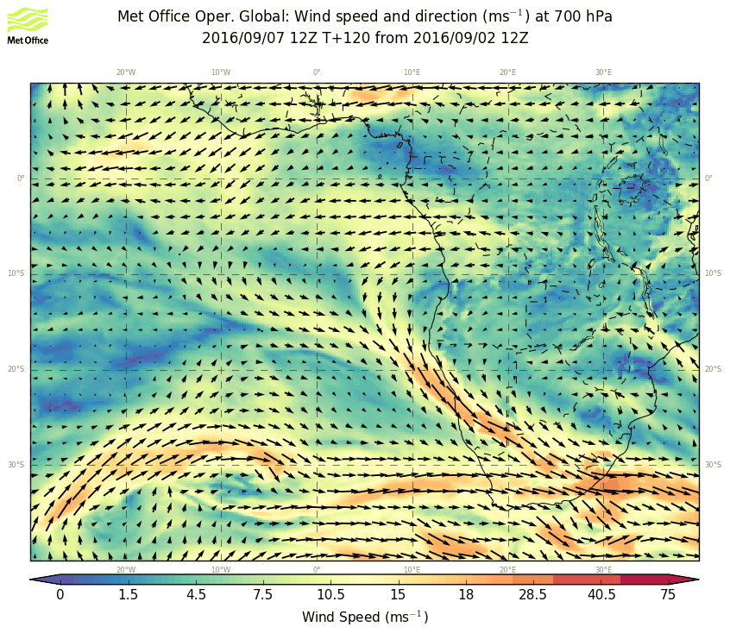
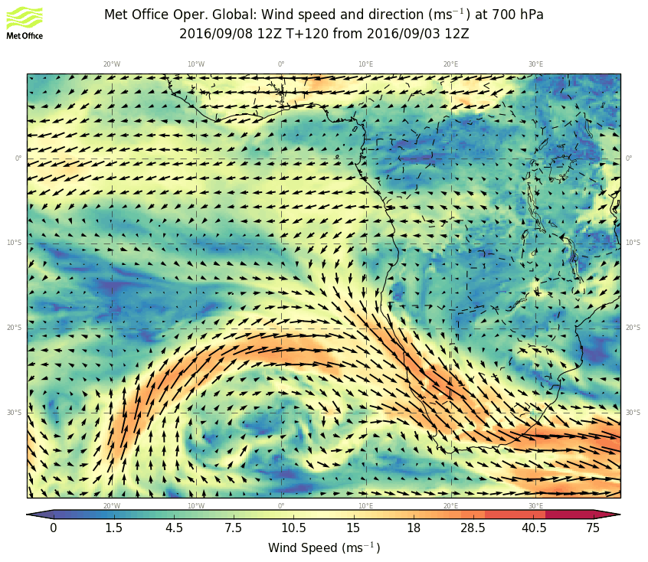
9/5 MONDAY, 12Z
9/7 Wednesday 12Z
WIND 700 hPA
9/6 TUESDAY, 12Z
9/8 Thursday12Z

Slide 6
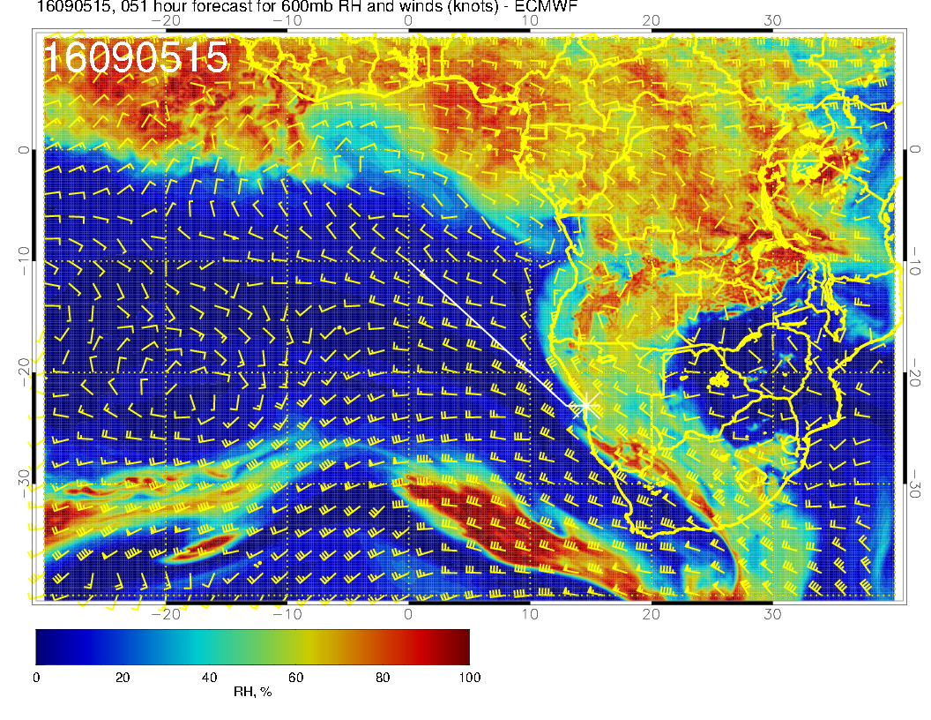
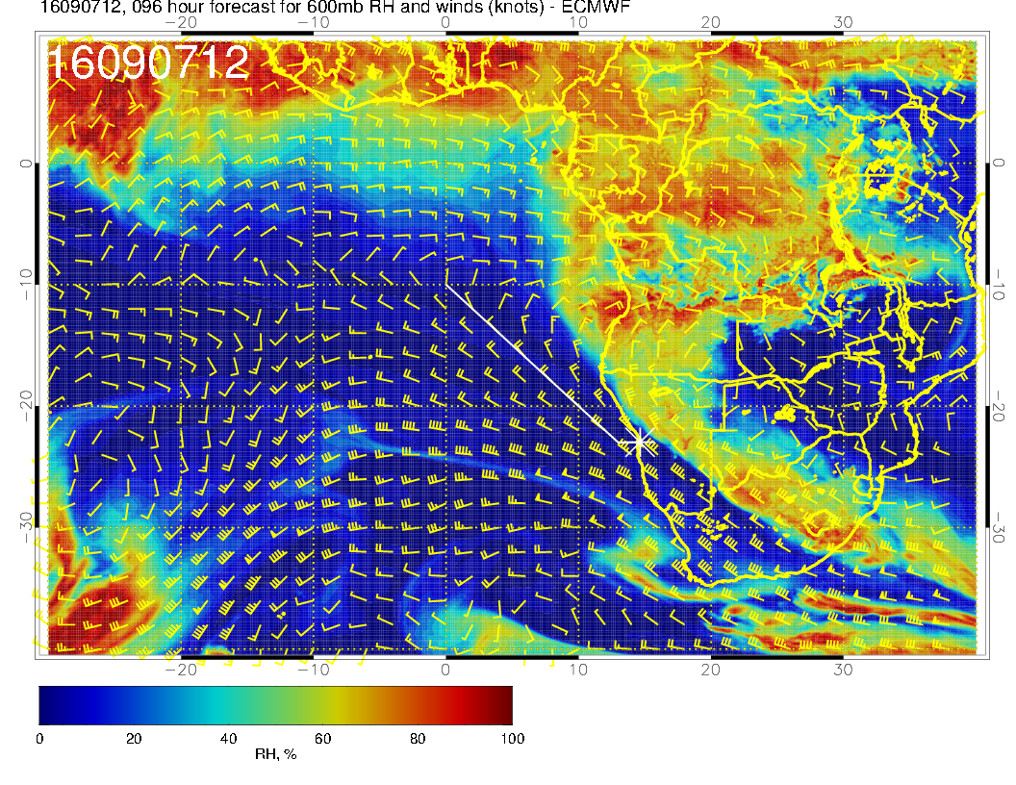
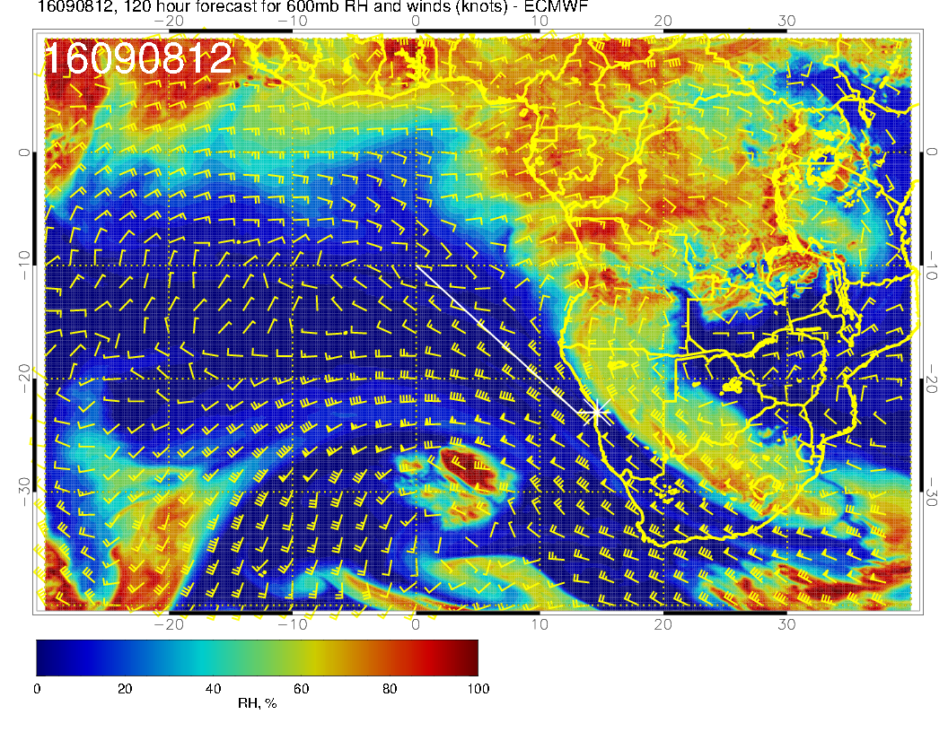
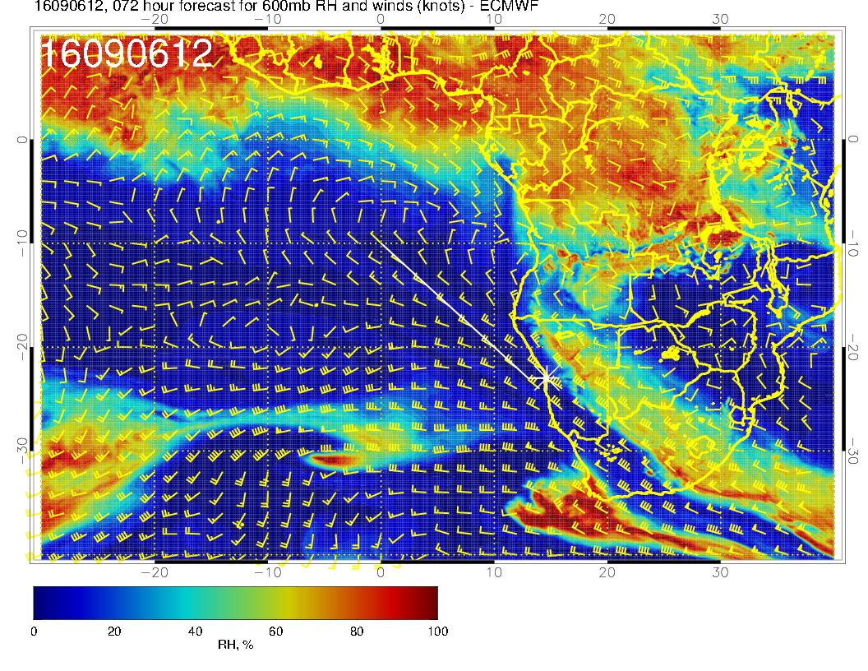
9/5 MONDAY, 15Z
9/7 Wednesday 12Z
WIND & RH 600 hPA
9/6 TUESDAY, 12Z
9/8 Thursday12Z

Slide 7
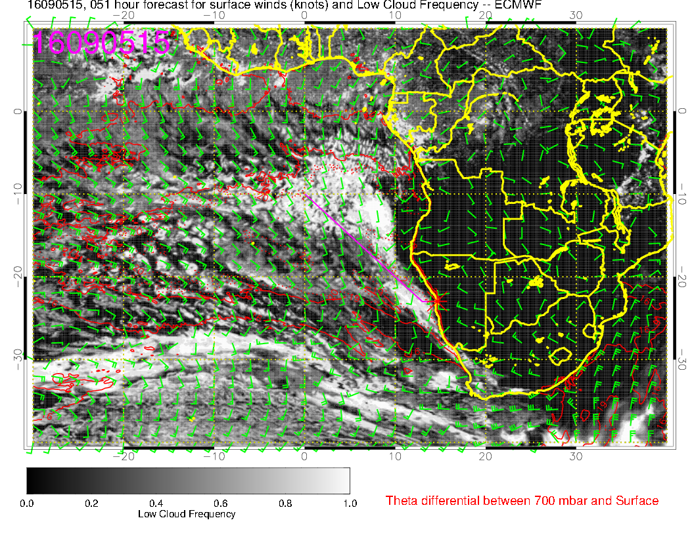
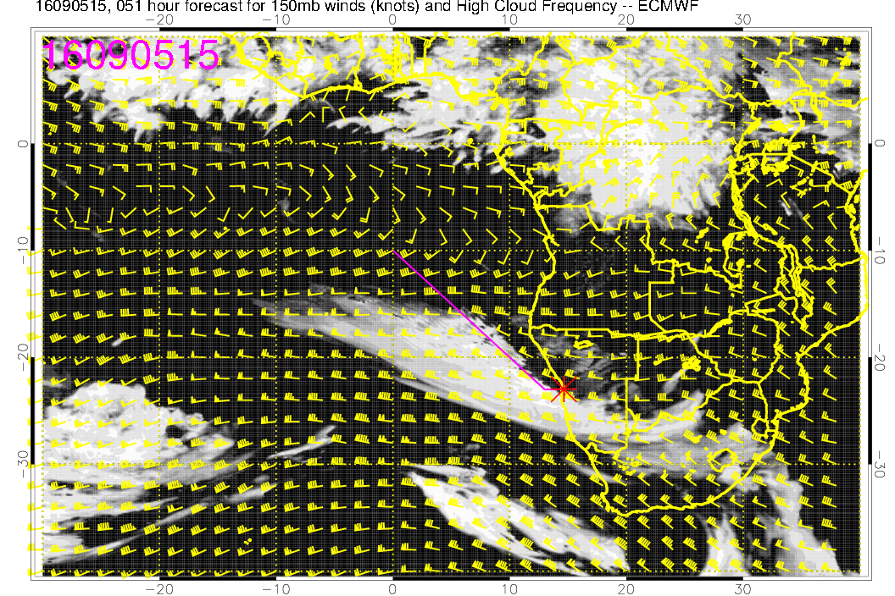
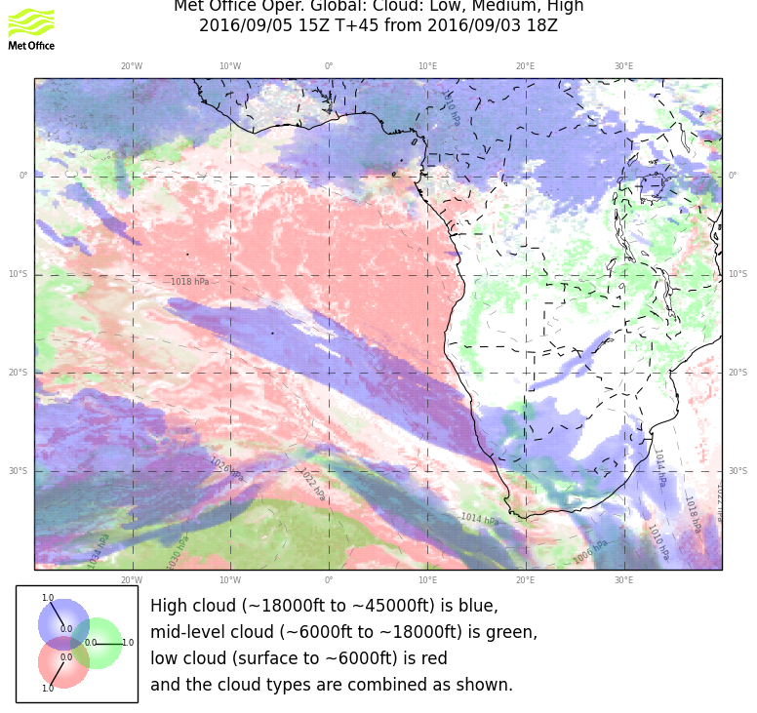
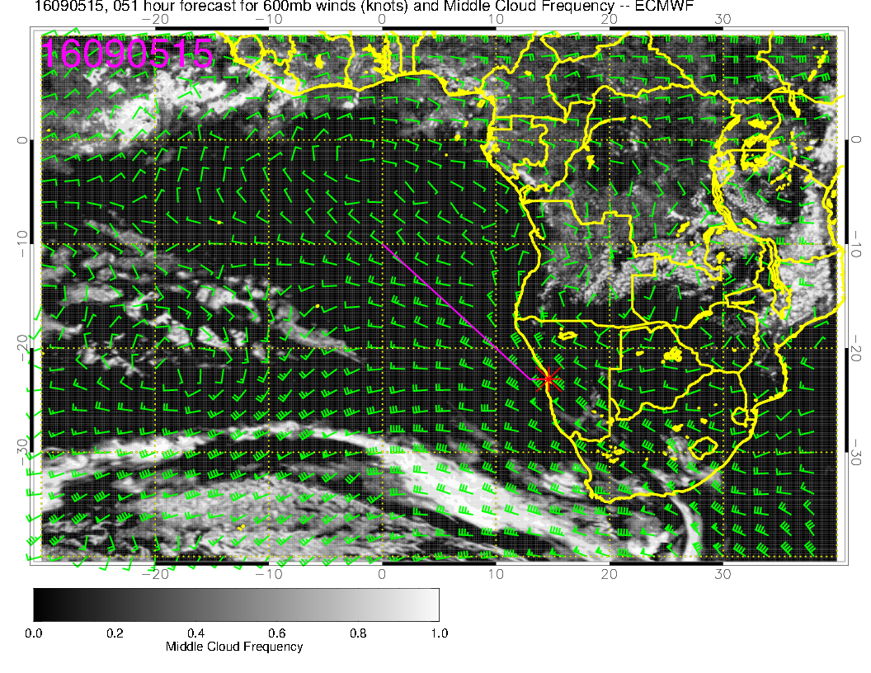
9/5 MONDAY, 15Z
Low
high
mid

Slide 8
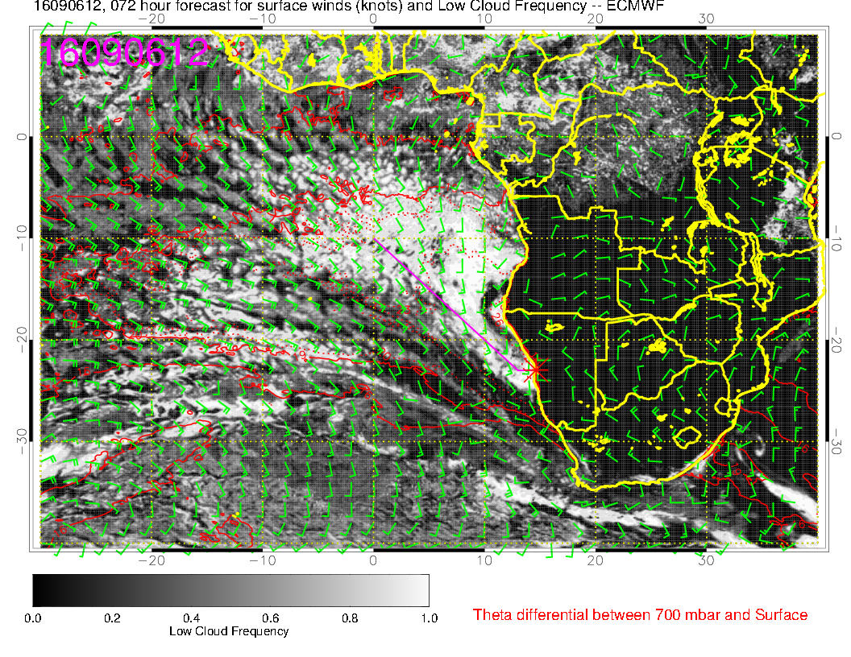
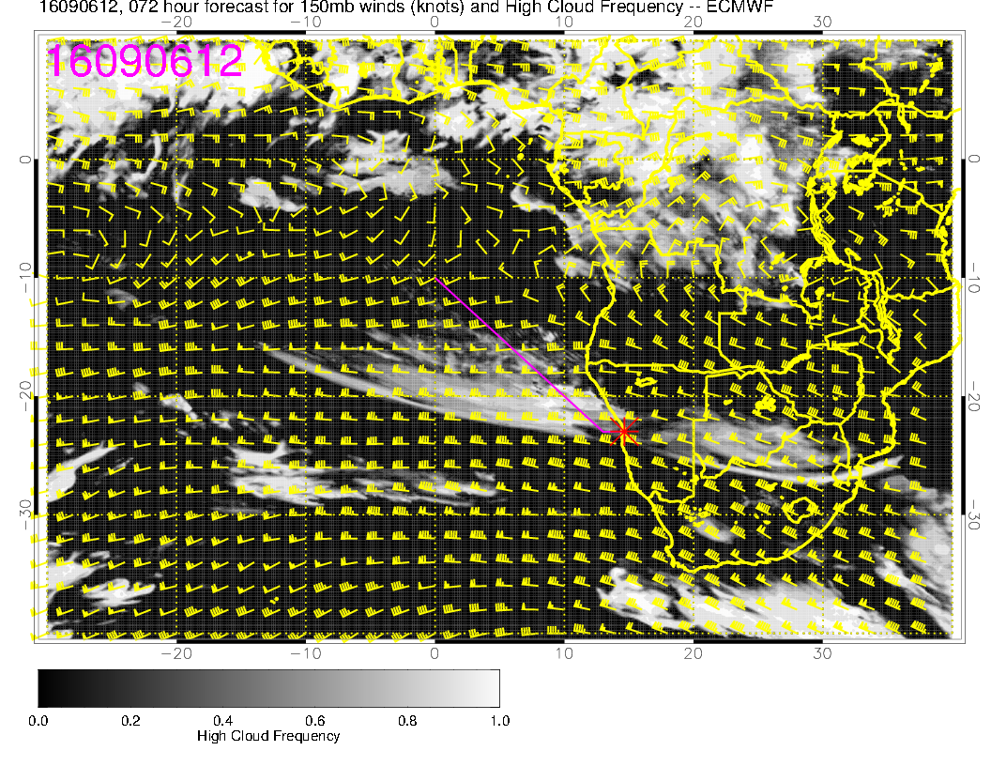
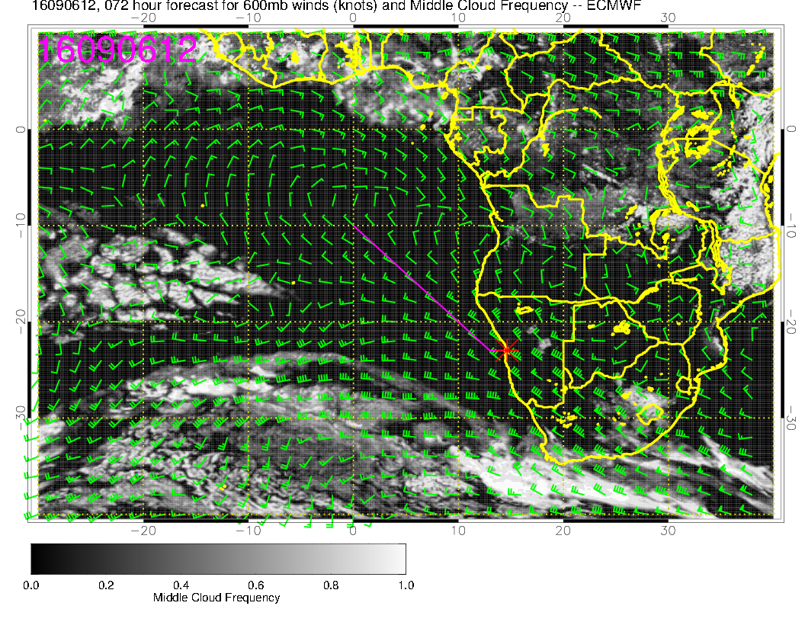
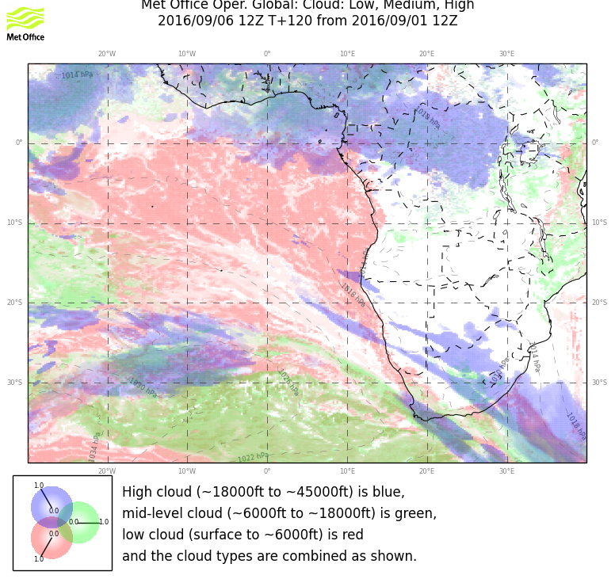
Low
high
9/6 TUEDAY, 12Z
mid

Slide 9
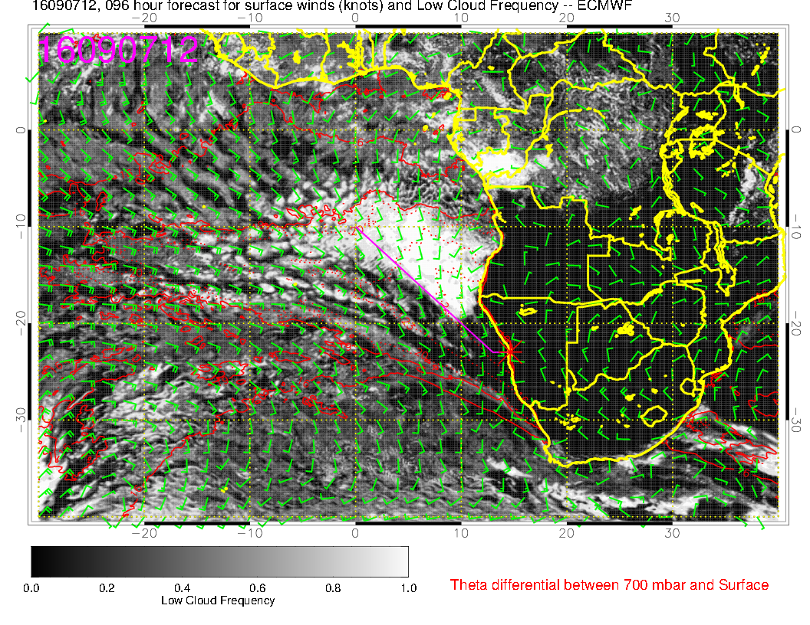
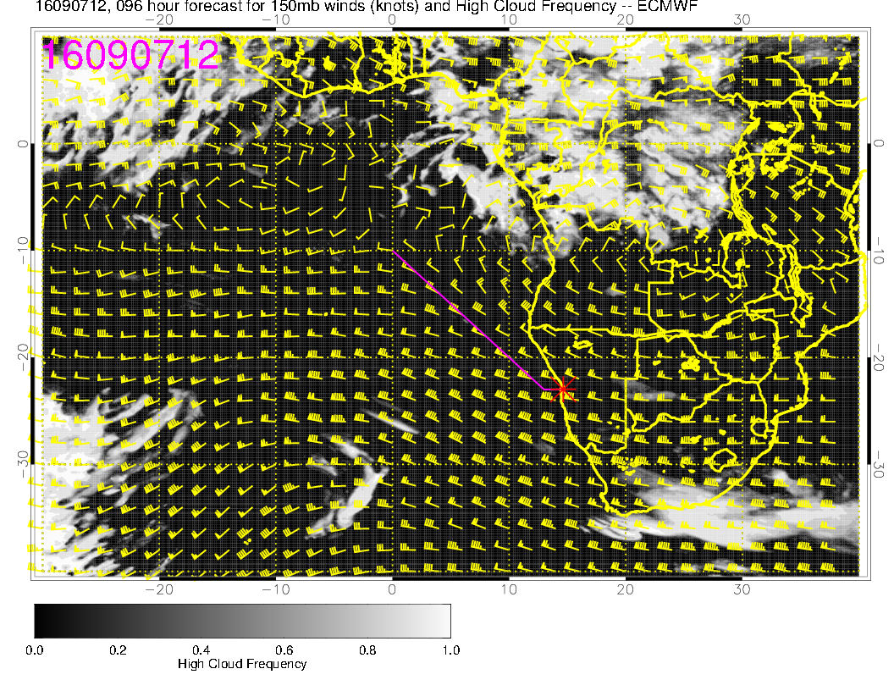
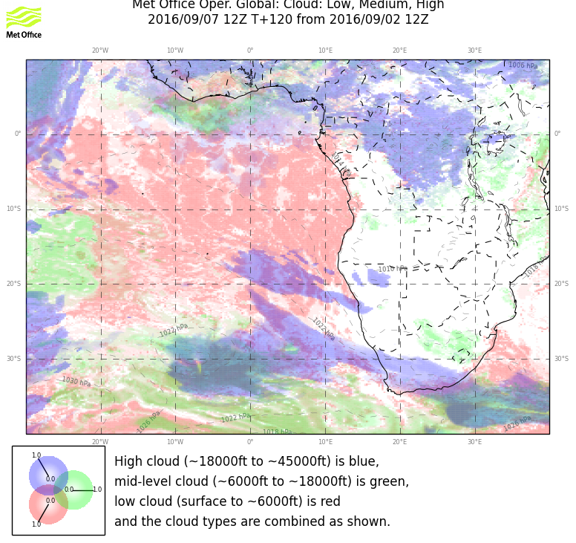
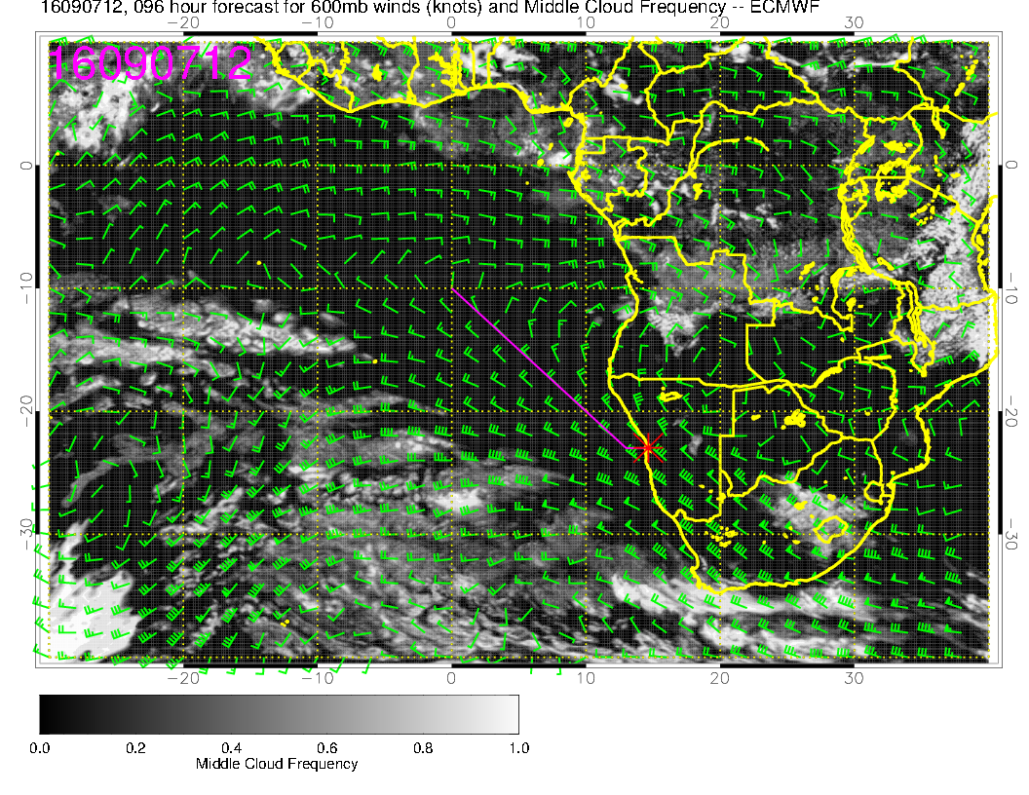
Low
high
9/7 WEDNESDAY, 12Z
mid

Slide 10
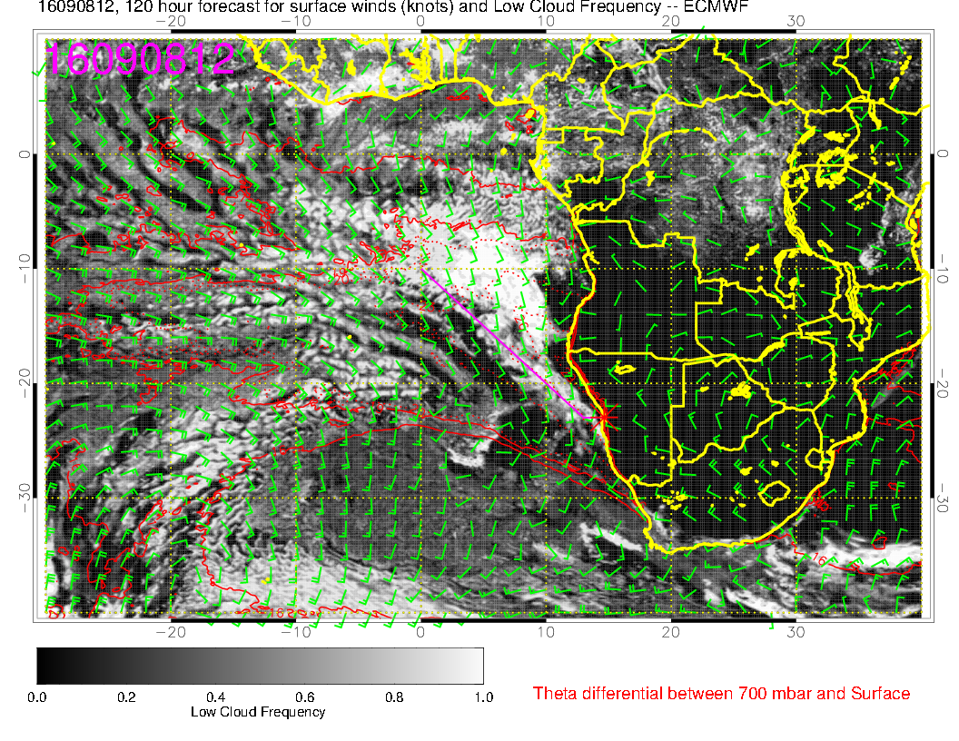
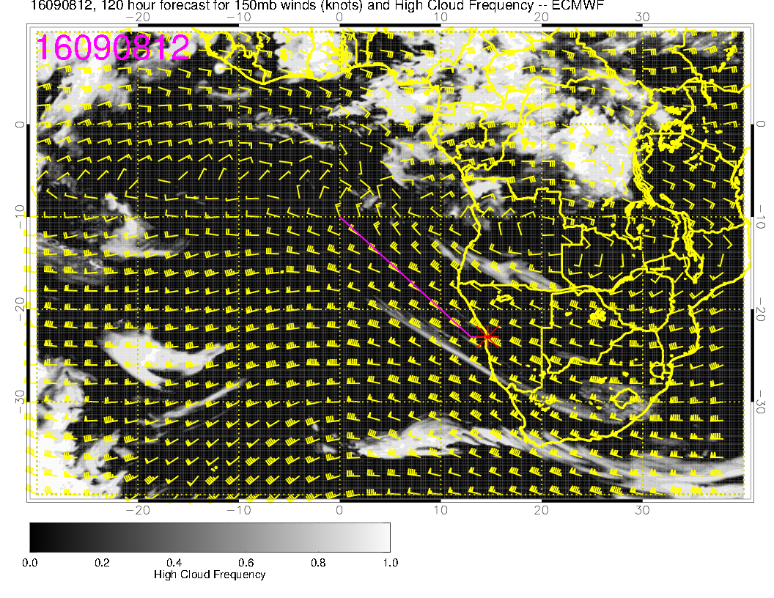
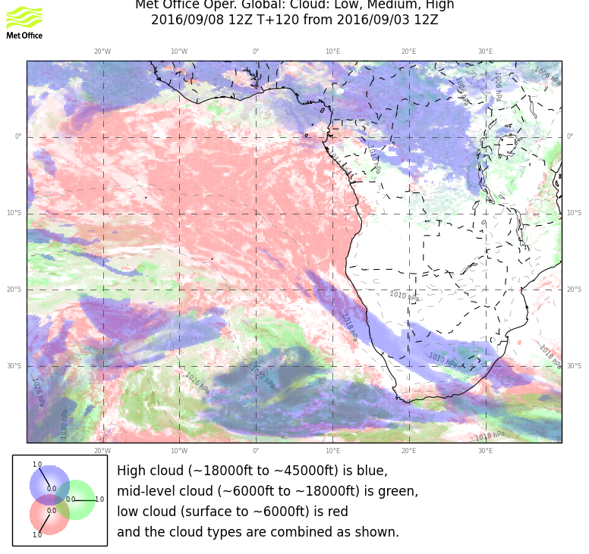
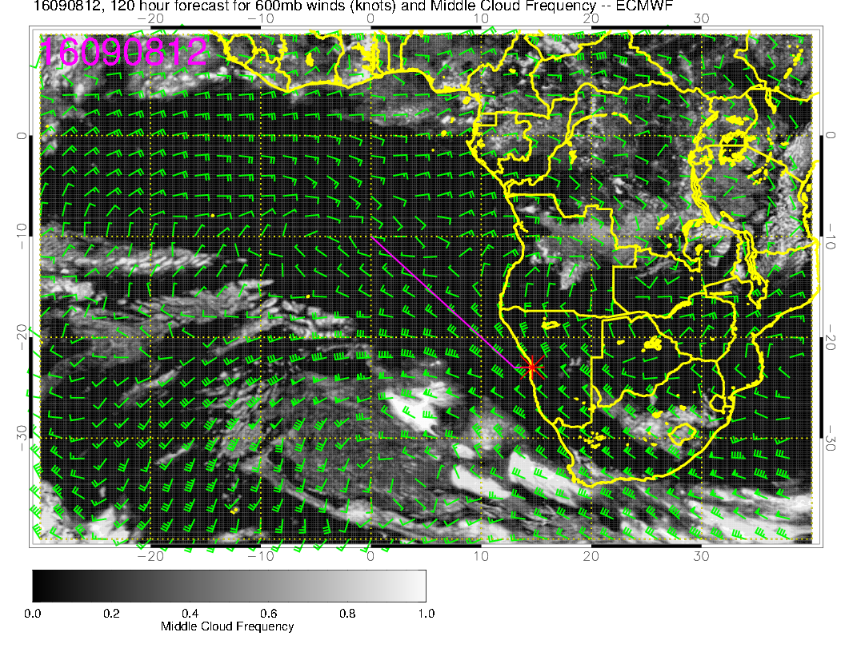
Low
9/8 THURSDAY, 12Z
high
mid

Slide 11
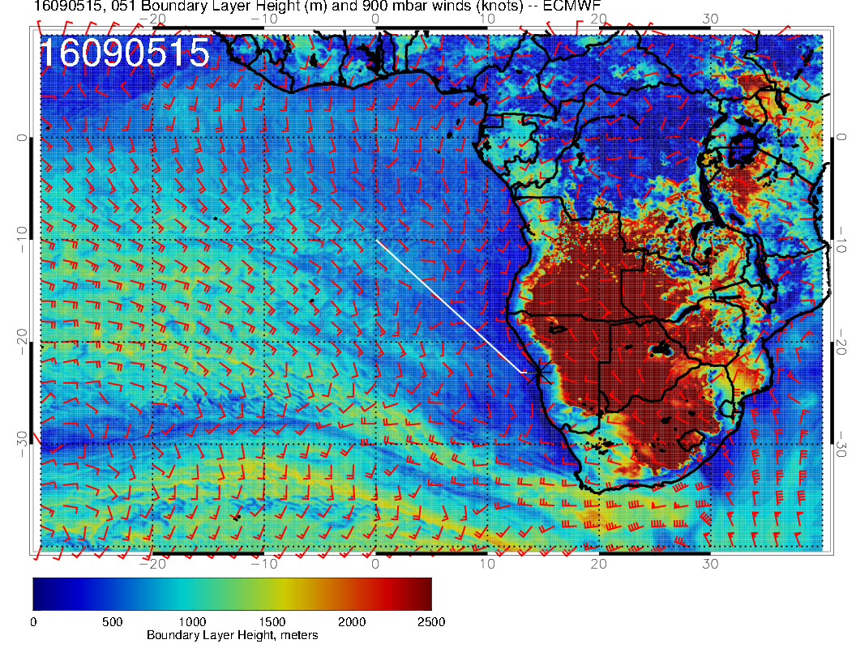
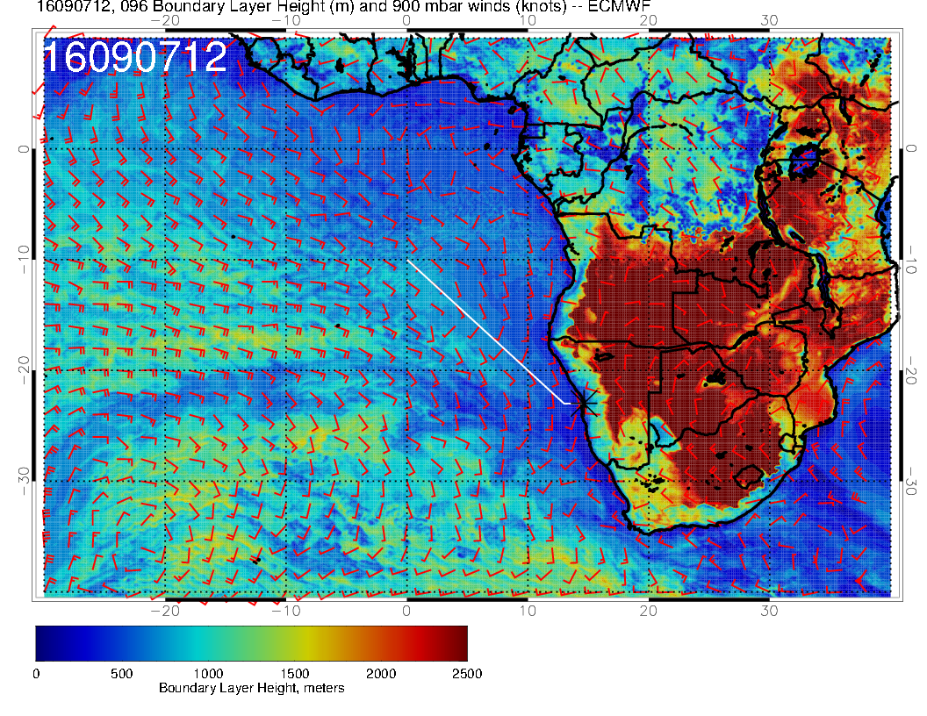
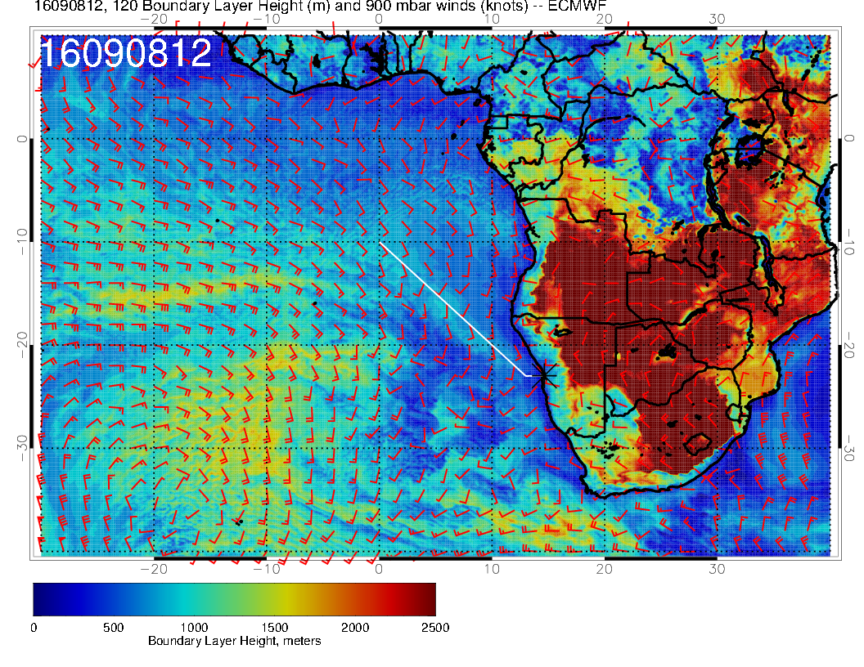
9/5 MONDAY, 15Z
9/7 Wednesday 12Z
9/6 TUESDAY, 12Z
9/8 THURSDAY, 12Z

Slide 12
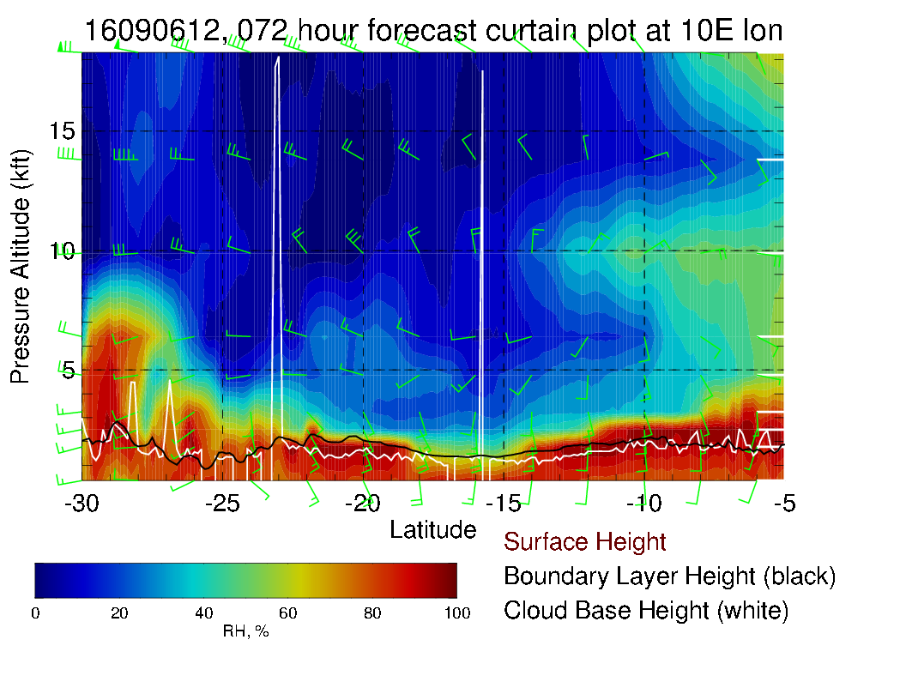
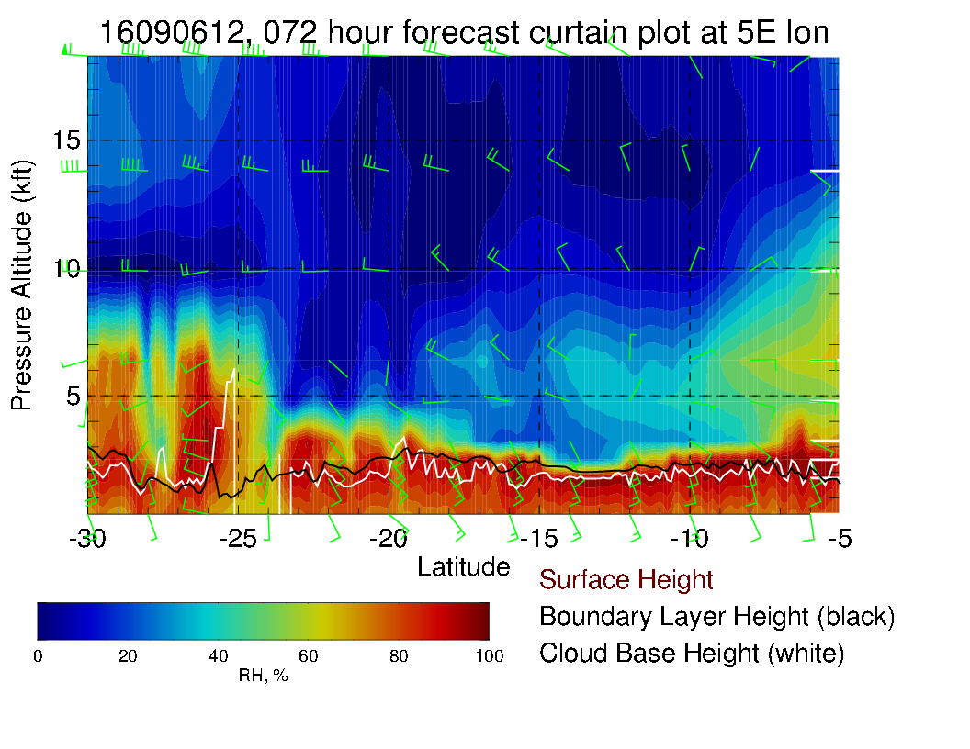
9/6 TUEDAY, 12Z

Slide 13
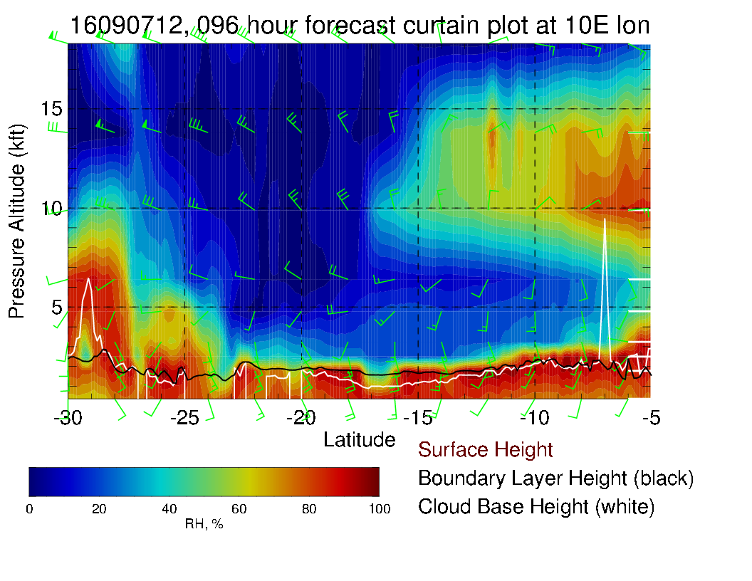
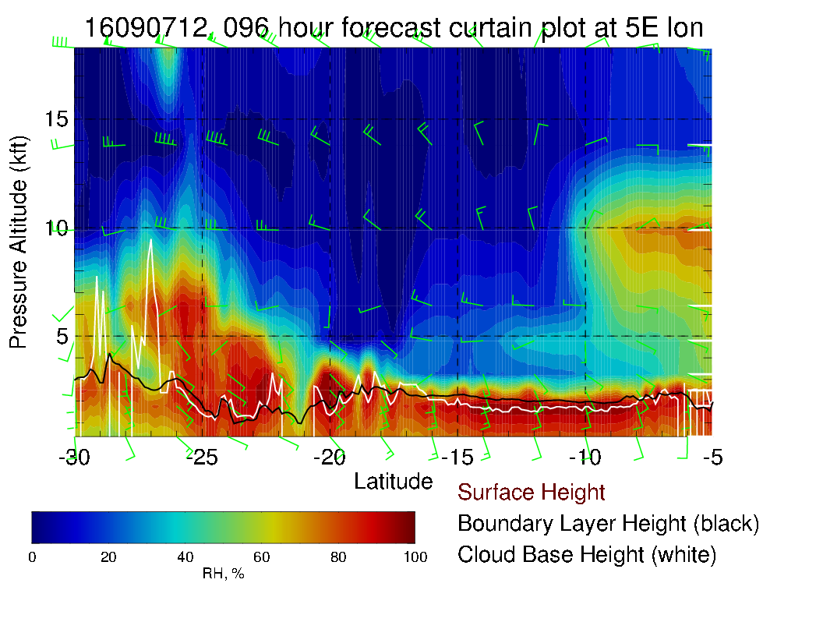
9/7 WEDNESDAY, 12Z

Slide 14
Summary Tuesday
Largest Sc deck forecasted compared to following days.
Low surface winds off-shore of Namibia (due to weakening front)
Models (Ukmet) show the lowest high cloud cover compared to the other days. ECMWF does show more.
Looks like a good day for cloud profiling – most homogenous cloud conditions.

Slide 15
Summary Other days
High cloud cover largest on Monday and smallest on Tuesday (UKmet) or Wednesday (ECMWF)
Low cloud shows opening along the coast line, However models disagree – on day and location
Boundary Layer height is becoming ‘bumpy’ on Thursday.
Tuesday and Wednesday good days to probe Sc, Thursday, forecasts diverges.
Monday less favorable.

